Slide 1

Single Image Super Resolution
Daniel Bonanno
Department of Communications and Computer Engineering
University of Malta

Slide 2
What is Super Resolution?
Assume a low resolution input image
What do we mean by low resolution? – Image has low quality!
Objective: Obtain a higher resolution image.
Solution:
Interpolation techniques (ex: bicubic interpolation) ?
Super Resolution?
With super resolution, we note that we get more detail
Here, we tackle single image super resolution

Slide 3

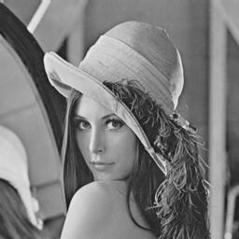

Can be obtained by bicubic interpolation
TargetOutput
Input

Slide 4
Method – Local Linear Embedding
Assumes similarity between high resolution patch space and low resolution patch space – Assumes Geometry is conserved
4
4
5
3
5
3
1
1
2
2
6
6
LR Space
HR Space

Slide 5


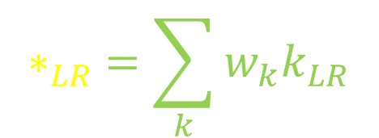

Assume an input LR patch and express it as a weighted sum of its k nearest neighbours.
Since only k neighbours will be used – solution is sparse, meaning that not all LR patches will have a weight!
4
5
3
$$w_{3}$$
$$∗_{LR} =\sum_{k}{w_{k}k_{LR}}$$
1
$$w_{1}$$
*
2
$$w_{2}$$
6
LR Space

Slide 6




Recall the initial assumption: Geometry is conserved!
This implies that we can transfer the weights and the neighbours from the LR space to the HR space to reconstruct the target HR patch
4
5
3
1
$$w_{3}$$
$$∗_{HR} =\sum_{k}{w_{k}k_{HR}}$$
$$w_{1}$$
*
2
6
$$w_{2}$$
HR Space

Slide 7
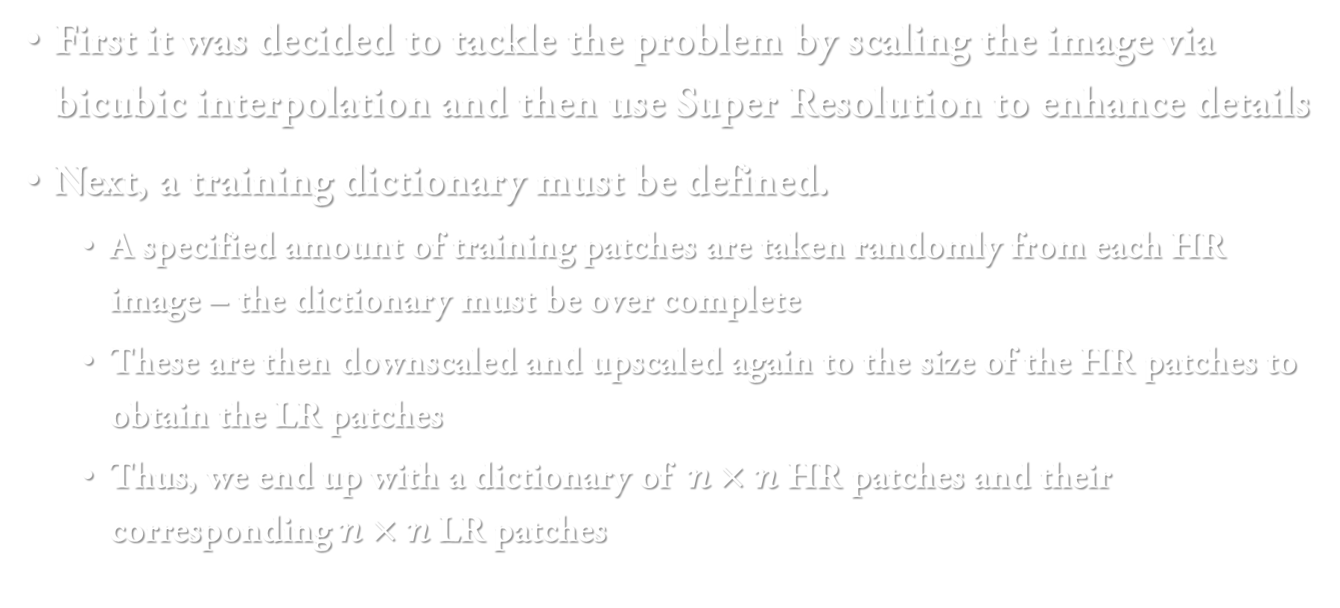
Implementation
First it was decided to tackle the problem by scaling the image via bicubic interpolation and then use Super Resolution to enhance details
Next, a training dictionary must be defined.
A specified amount of training patches are taken randomly from each HR image – the dictionary must be over complete
These are then downscaled and upscaled again to the size of the HR patches to obtain the LR patches
Thus, we end up with a dictionary of $n×n$ HR patches and their corresponding $n×n$ LR patches

Slide 8
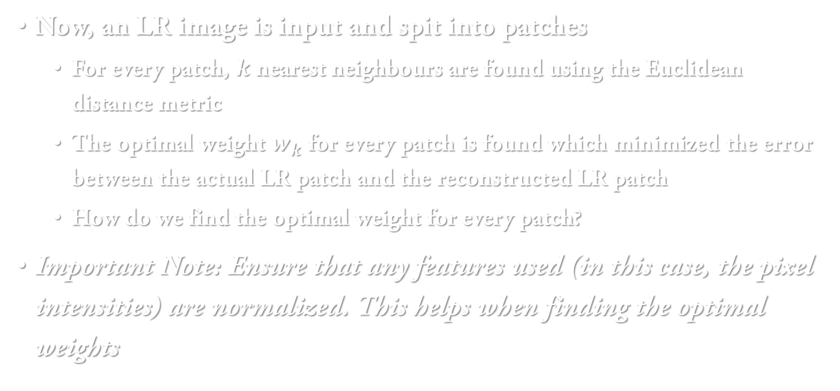
Now, an LR image is input and spit into patches
For every patch, $k$ nearest neighbours are found using the Euclidean distance metric
The optimal weight $w_{k}$ for every patch is found which minimized the error between the actual LR patch and the reconstructed LR patch
How do we find the optimal weight for every patch?
Important Note: Ensure that any features used (in this case, the pixel intensities) are normalized. This helps when finding the optimal weights

Slide 9
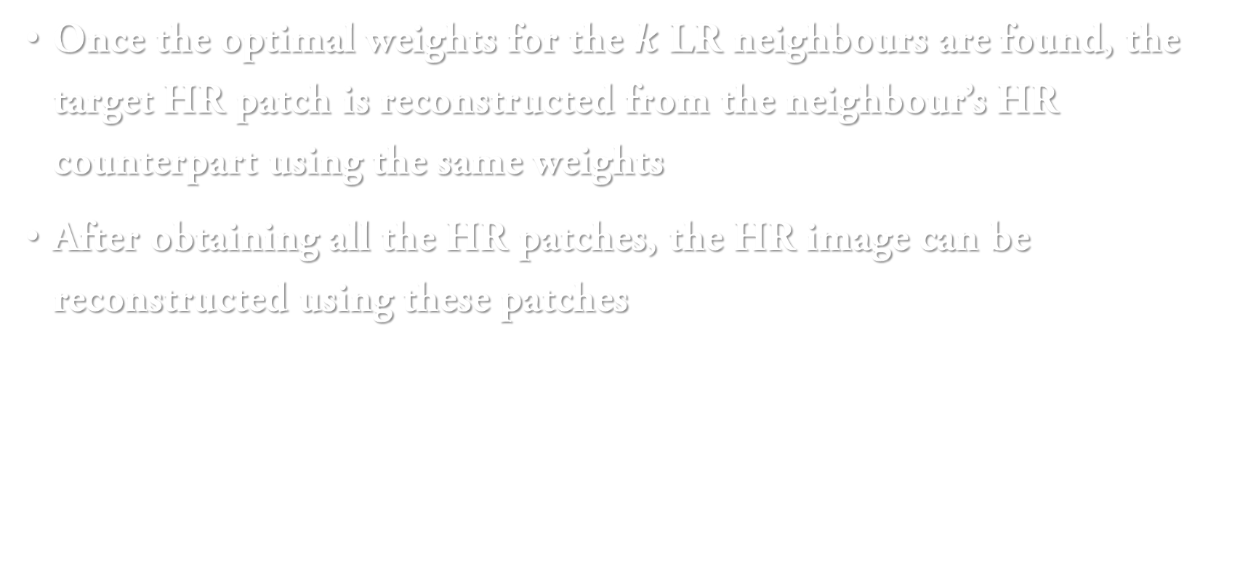
Once the optimal weights for the $k$ LR neighbours are found, the target HR patch is reconstructed from the neighbour’s HR counterpart using the same weights
After obtaining all the HR patches, the HR image can be reconstructed using these patches

Slide 10
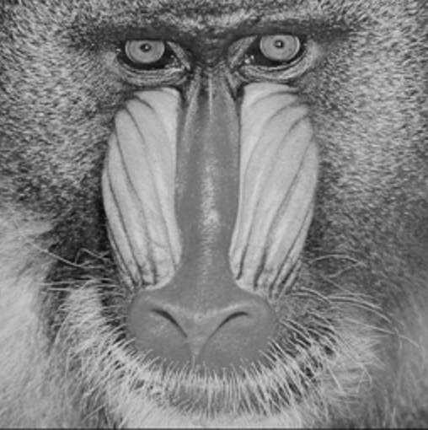







1
LR Image
2
LR Space
4
5
3
$$w_{3}$$
1
$$w_{1}$$
*
2
$$w_{2}$$
6
4
5
3
$$w_{3}$$
1
$$w_{1}$$
*
2
6
$$w_{2}$$
4
HR Image
3
HR Space

Slide 11
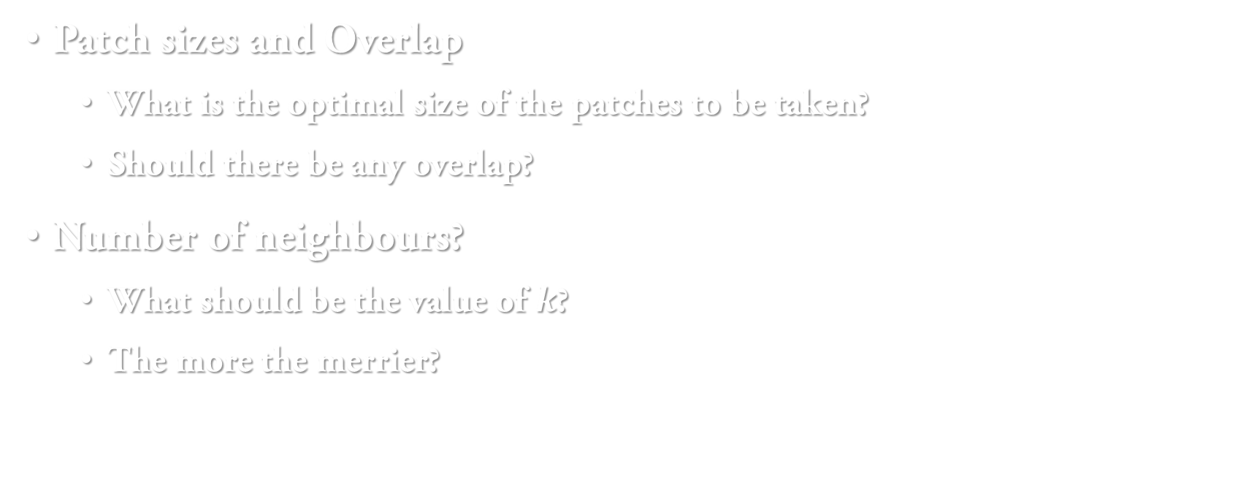
Parameters
Patch sizes and Overlap
What is the optimal size of the patches to be taken?
Should there be any overlap?
Number of neighbours?
What should be the value of $k$?
The more the merrier?

Slide 12
Parameters – Patch Size and Overlap
It was noted that with no overlap, there are blocking artefacts present
Expected since this causes discontinuities
Overlap must be present, but how much?
Testing using 20 images and using the PSNR as a metric, it was observed that the optimal patch size is 4 with an overlap of 2
This was also verified visually

Slide 13
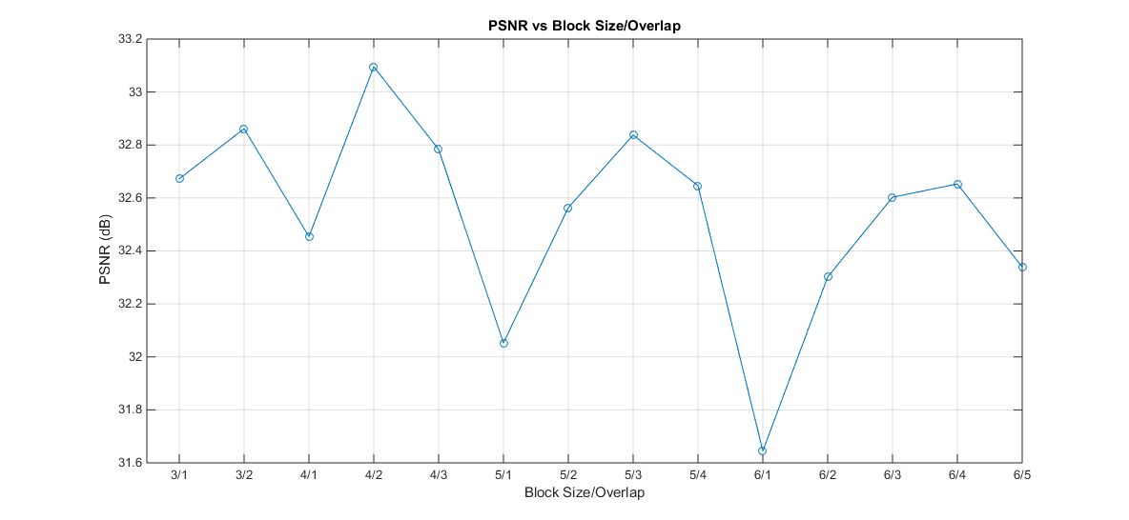
Note that the same overlap when taking the patches from the LR image must be present when taking the HR images
This means that pixel intensities must be averaged where overlap between HR patches is present

Slide 14
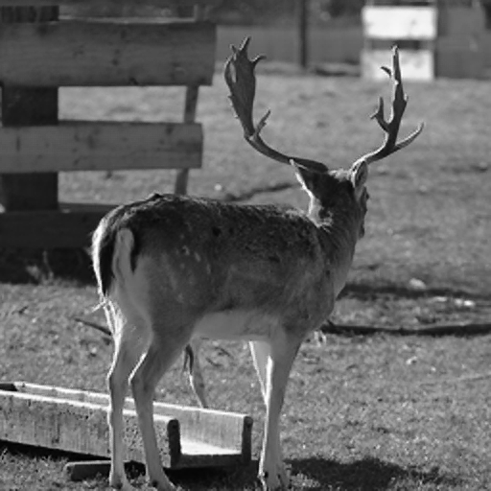

Block Size 4, Overlap 2
Block Size 6, Overlap 5

Slide 15


Block Size 4, Overlap 2
Block Size 6, Overlap 5

Slide 16
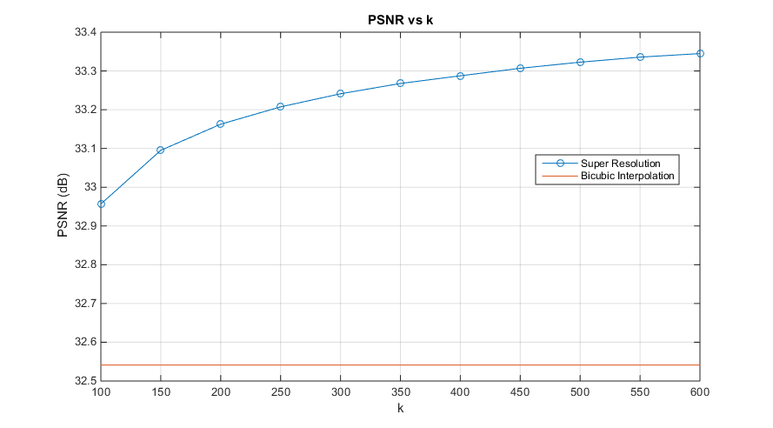

Parameters – $k$
It seems intuitive that the more neighbours we have, the better the reconstruction of the LR and HR patches.
This seems to be supported by testing

Slide 17
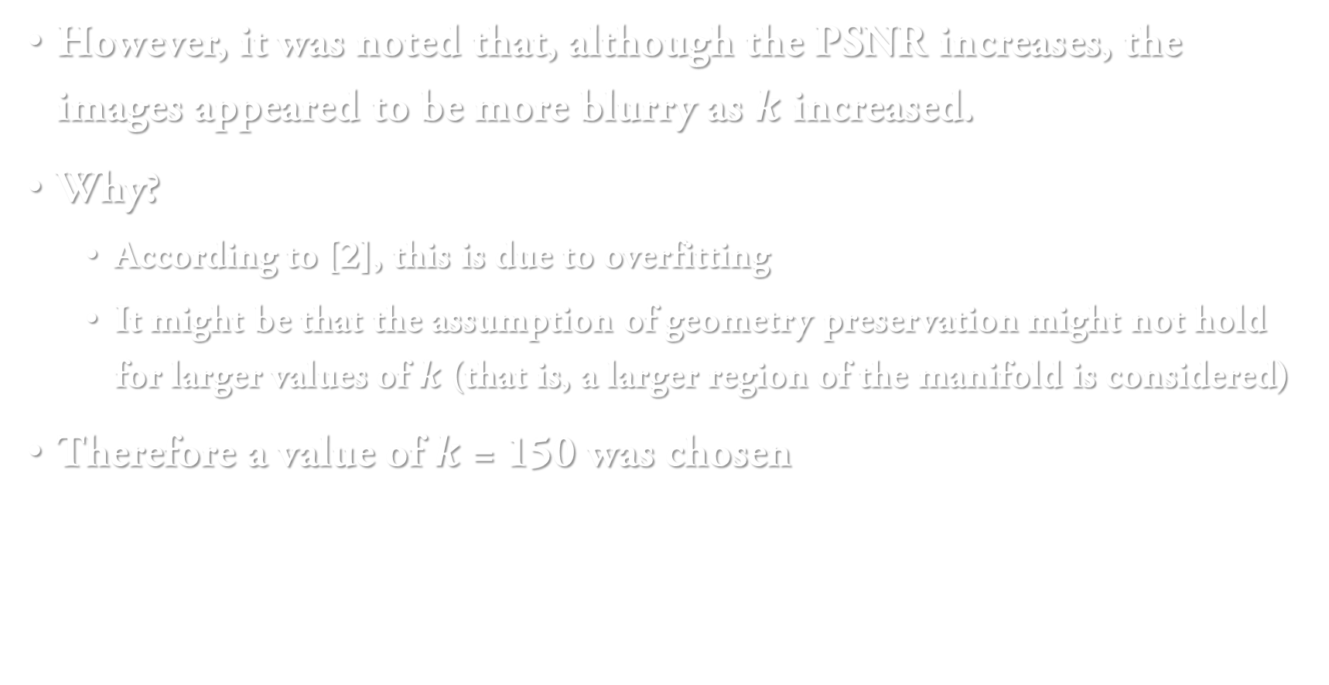
However, it was noted that, although the PSNR increases, the images appeared to be more blurry as $k$ increased.
Why?
According to [2], this is due to overfitting
It might be that the assumption of geometry preservation might not hold for larger values of $k$ (that is, a larger region of the manifold is considered)
Therefore a value of $k$ = 150 was chosen

Slide 18
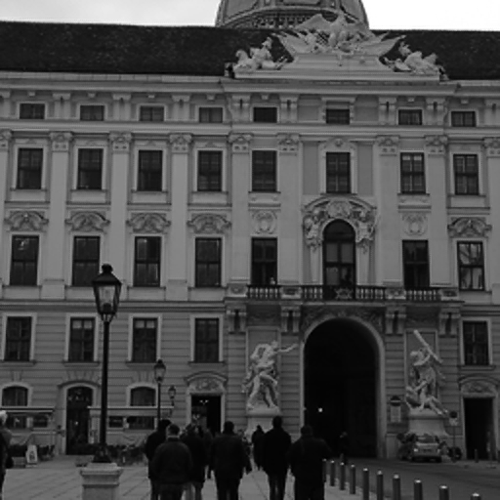



$k$ = 150
$k$ = 1000

Slide 19


$k$ = 150
$k$ = 1000

Slide 20
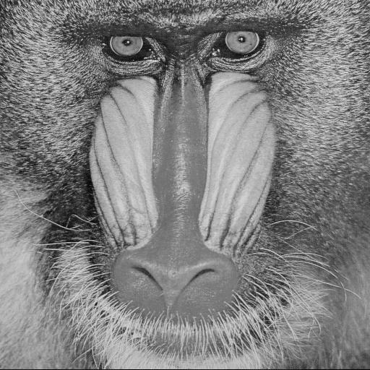
Original Image
Some Examples

Slide 21

Bicubic InerpolatedImage PSNR: 23.4841 dB

Slide 22

Super Resolution Image PSNR: 23.4386 dB

Slide 23
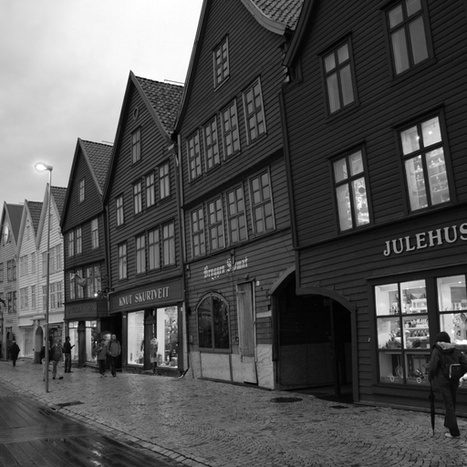
Original Image

Slide 24

Bicubic InerpolatedImage PSNR: 28.5956 dB

Slide 25

Super Resolution Image PSNR: 29.2670 dB

Slide 26
Possible Improvements
Investigate other distance measures, not just Euclidean
Improve the dictionary
Not the quantity of patches but the difference between the patches
Having said that, quantity is still important
Different set of features

Slide 27
References
[1] Local Linear Embedding Available: https://www.cs.nyu.edu/~roweis/lle/ [Accessed: 21/05/2017]
[2] Jianchao Yang, J. Wright, T. S. Huang, and Yi Ma, “Image Super-Resolution Via Sparse Representation,” IEEE Trans. Image Process., vol. 19, no. 11, pp. 2861–2873, Nov. 2010.
[3] “BOSSbase Image Database” [Online]. Available: http://agents.fel.cvut.cz/stegodata/PGMs/. [Accessed: 7-May-2017]
Reference Paper:
Hong Chang, Dit-Yan Yeung, and Yimin Xiong, “Super-resolution through neighbor embedding,” Proc. 2004 IEEE Comput. Soc. Conf. Comput. Vis. Pattern Recognition, 2004. CVPR 2004., vol. 1, pp. 275–282, 2004.

Slide 28
Thank You!

